Slide 1
Unsupervised Learning k-Means, LVQ, SOM

Slide 2
Unsupervised Learning
We have no external error information
No task-specific error criterion
Generate internal error
Must be general
Usual method is to cluster data together according to activation of neurons
Competitive learning

Slide 3
Competitive Learning
Set of neurons compete to fire
Neuron that ‘best matches’ the input (has the highest activation) fires
Winner-take-all
Neurons ‘specialize’ to recognize some input

Slide 4
The k-Means Algorithm
Suppose that you know the number of clusters, but not what the clusters look like
How do you assign each data point to a cluster?
Position k centers at random in the space
Assign each point to its nearest center according to some chosen distance measure
Move the center to the mean of the points (the centroid) that it represents
Iterate
The centroid is the average position of all the points of an object. The center of gravity is the same as the centroid when the density is the same throughout.

Slide 5
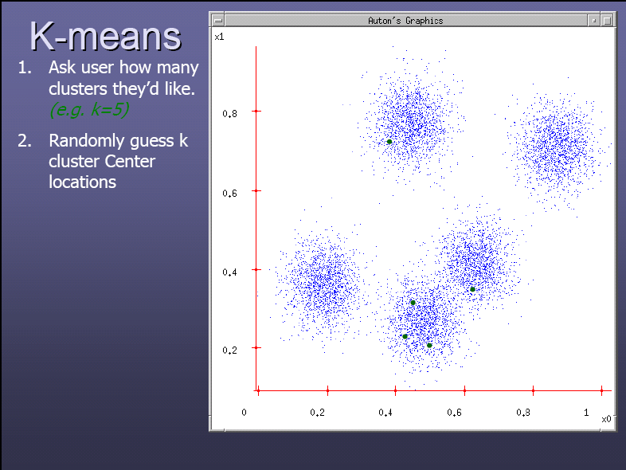
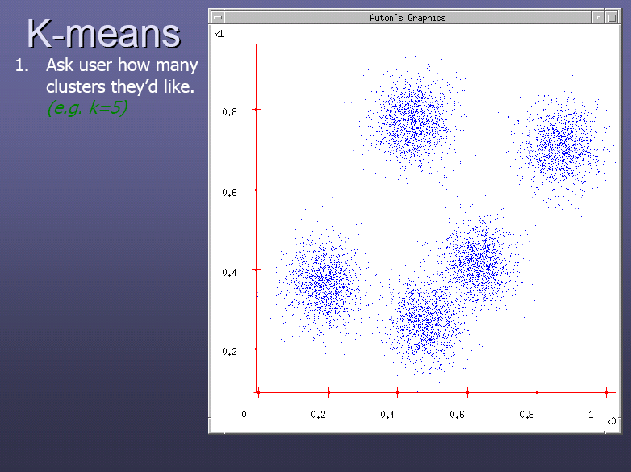

Slide 7
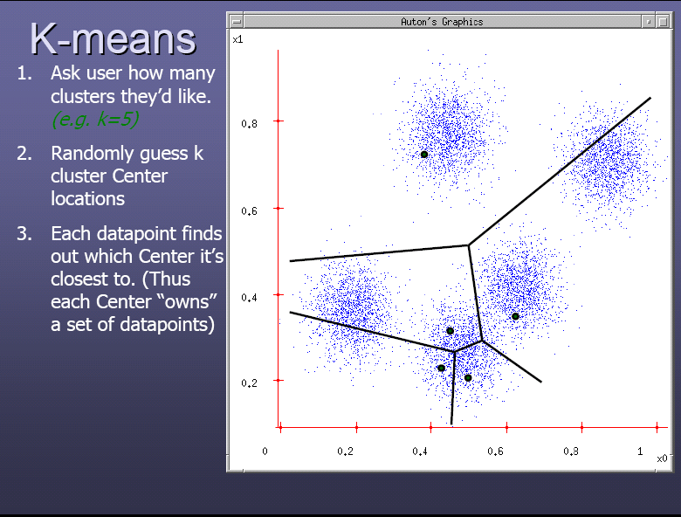

Slide 8
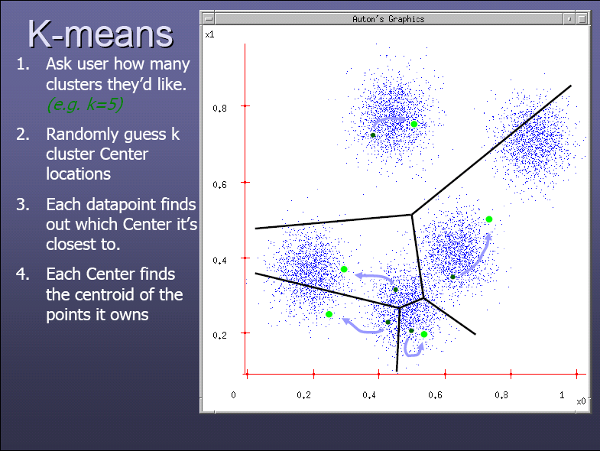

Slide 9
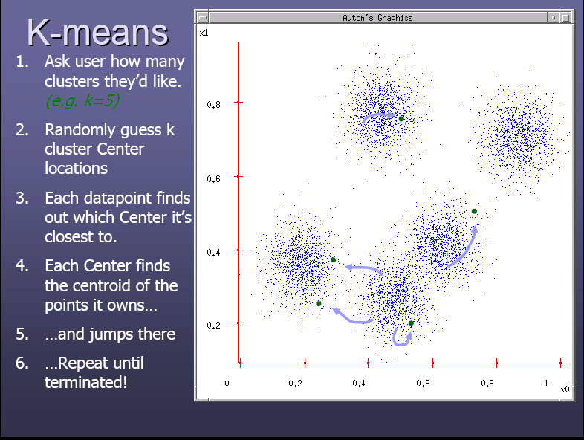

Slide 10
Animation: http://tech.nitoyon.com/en/blog/2013/11/07/k-means/

Slide 11
Stopping/convergence criterion
k-Means is convergent
(see https://www.cse.iitb.ac.in/~shivaram/teaching/old/cs344+386-s2017/resources/classnote-2.pdf)
However, it can be stopped earlier, when you have:
Very few re-assignments of data points to different clusters, or
very few change of centroids, or
minimum decrease in the sum of squared error (SSE),
where: C_{i} is the j-th cluster, m_{j} is the centroid of cluster C_{j} (the mean vector of all the data points in C_{j}), and dist(x, m_{j}) is the distance between data point x and centroid m_{j}

Slide 12
Example distance functions
Let x_{i} = (a_{i1}, ..., a_{in}) and x_{j} = (a_{j1}, ...,a_{jn})
Euclidean distance:
Manhattan (city block) distance:

Slide 13
Distance function for text documents
A text document consists of a sequence of sentences and each sentence consists of a sequence of words.
To simplify: a document is usually considered a “bag” of words in document clustering.
Sequence and position of words are ignored.
A document is represented with a vector just like a normal data point.
Distance between two documents is the cosine of the angle between their corresponding feature vectors.

Slide 14
Weaknesses of k-Means
The algorithm is only applicable if the mean is defined.
For categorical data, k-mode - the centroid is represented by most frequent values.
The user needs to specify k.
The algorithm is sensitive to outliers
Outliers are data points that are very far away from other data points.
Outliers could be errors in the data recording or some special data points with very different values.
k-means is sensitive to initial random centroids

Slide 15
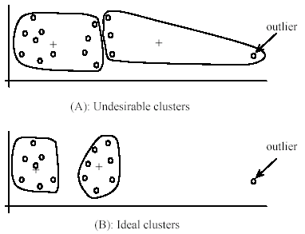
Weaknesses of k-Means: Problems with outliers

Slide 16
Dealing with outliers
One method is to remove some data points in the clustering process that are much further away from the centroids than other data points.
To be safe, we may want to monitor these possible outliers over a few iterations and then decide to remove them.
Another method is to perform random sampling. Since in sampling we only choose a small subset of the data points, the chance of selecting an outlier is very small.
Assign the rest of the data points to the clusters by distance or similarity comparison, or classification

Slide 17
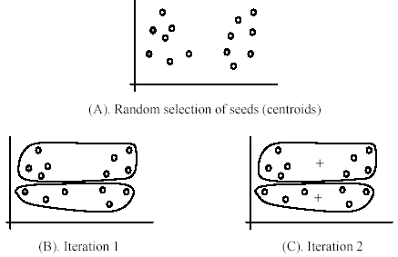
Weaknesses of k-Means (cont …)
The algorithm is sensitive to initial seeds.
+
+

Slide 18
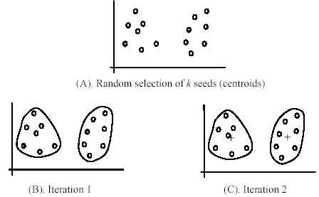
Weaknesses of k-Means (cont …)
If we use different seeds: good results
+
There are some methods to help choose good seeds
+

Slide 19
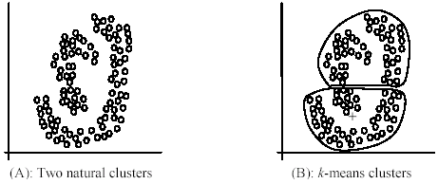
Weaknesses of k-Means (cont …)
The k-Means algorithm is not suitable for discovering clusters that are not hyper-ellipsoids (or hyper-spheres).
+

Slide 20
k-Means improvements
Run the algorithm for many values of k
Pick the one with lowest error, up to total overfitting (when you have one data point / cluster)
Run the algorithm from many starting points
Avoids local minima?

Slide 21
k-Means Summary
Despite weaknesses, k-Means is still the most popular algorithm due to its simplicity, efficiency and
other clustering algorithms have their own lists of weaknesses.
No clear evidence that any other clustering algorithm performs better in general
although they may be more suitable for some specific types of data or applications.

Slide 22
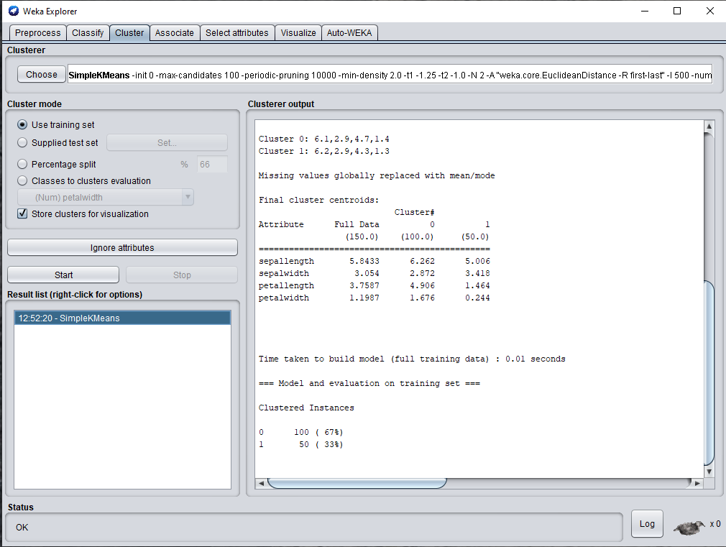
k-Means in WEKA for Iris data: 2 clusters

Slide 23
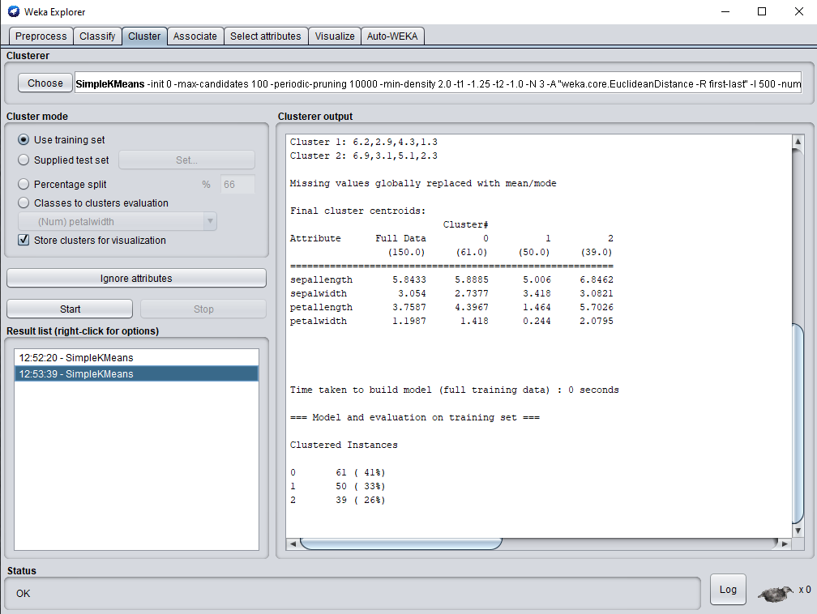
k-Means in WEKA for Iris data: 3 clusters

Slide 24
k-Means Neural Network
Use winner-take-all neurons
Winning neuron is the one closest to input
Best-matching cluster
How do we do training?
Update weights - move neuron positions
Move winning neuron i towards current input x by decreasing the distance between their components
Ignore the rest

Slide 25
Normalization
Suppose the weights are:
(0.2, 0.2, -0.1)
(0.15, -0.15, 0.1)
(10, 10, 10)
w₂
w₁
w₃

Slide 26
Normalization
For a perfect match with first neuron:
0.2*0.2 + 0.2*0.2 + -0.1*-0.1 = 0.09
0.15*0.2 + -0.15*0.2 + 0.1*-0.1 = -0.01
10*0.2 + 10*0.2 + 10*-0.1 = 3
Can only compare activations if the weights are about the same size

Slide 27
Normalization
Make the distance between each neuron and the origin be 1
All neurons lie on the unit hypersphere
Need to stop the weights growing unboundedly

Slide 28
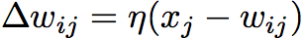
k-Means Neural Network
Normalize inputs too
Then use:

Slide 29
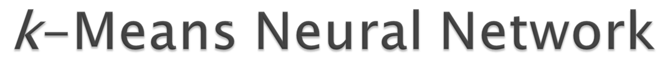

Slide 30
Vector Quantization (VQ)
Originally used for data compression
Works by dividing a large set of points (vectors) into groups having approximately the same number of points closest to them
Data points are represented by the index of their closest centroid
VQ is based on the competitive learning
Used in self-organizing maps and deep learning (auto-encoder)

Slide 31
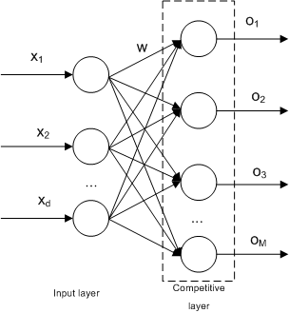
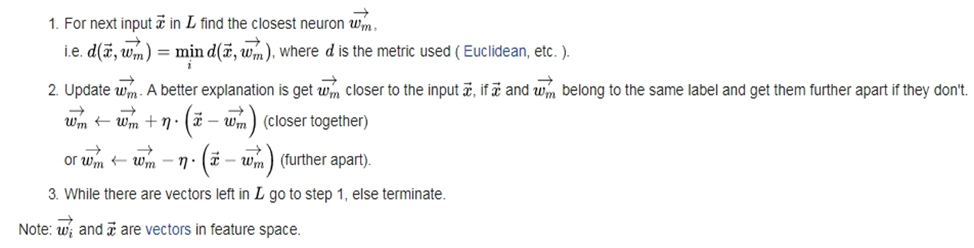
Learning Vector Quantization (LVQ)
LVQ can be understood as a special case of a neural network. It applies a winner-take-all Hebbian learning-based approach. It is a precursor to self-organizing maps.

Slide 32
LVQ
The winner is moved closer if it correctly classifies the data point or moved away if it classifies the data point incorrectly.
The vectors are called codebook vectors, or prototypes.
A key issue in LVQ is the choice of an appropriate measure of distance or similarity measure (the d function).
It is a generalization of the k-Means Neural Network.
There is also a supervised version of LVQ that can be used when we have labeled input data.

Slide 33
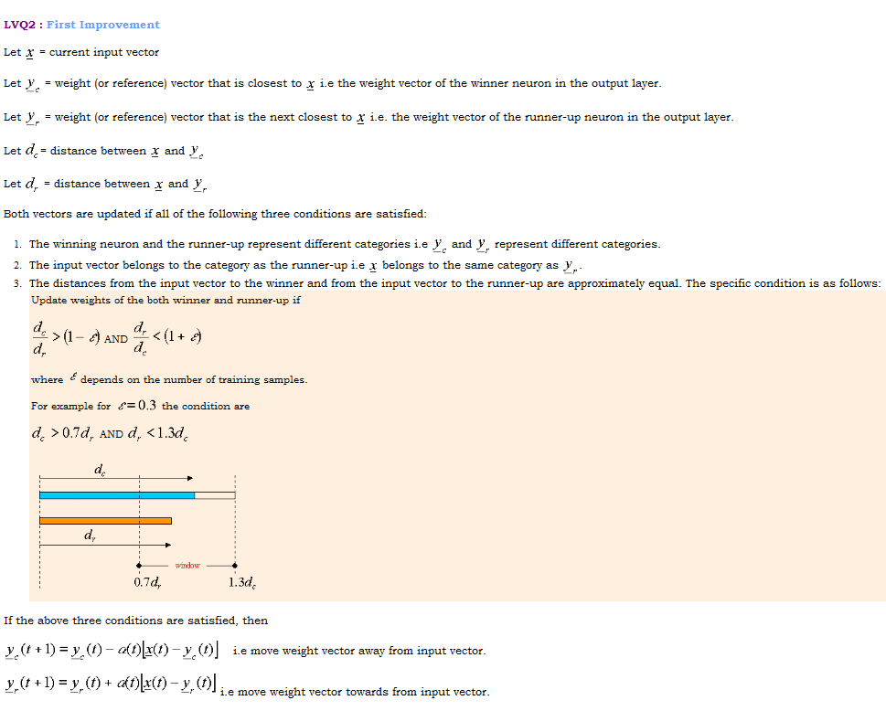

Slide 34
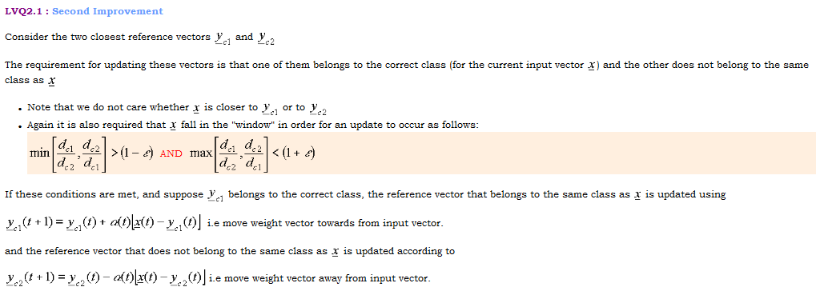
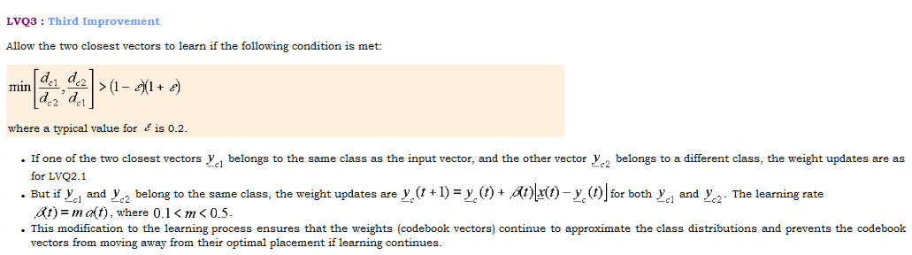

Slide 35
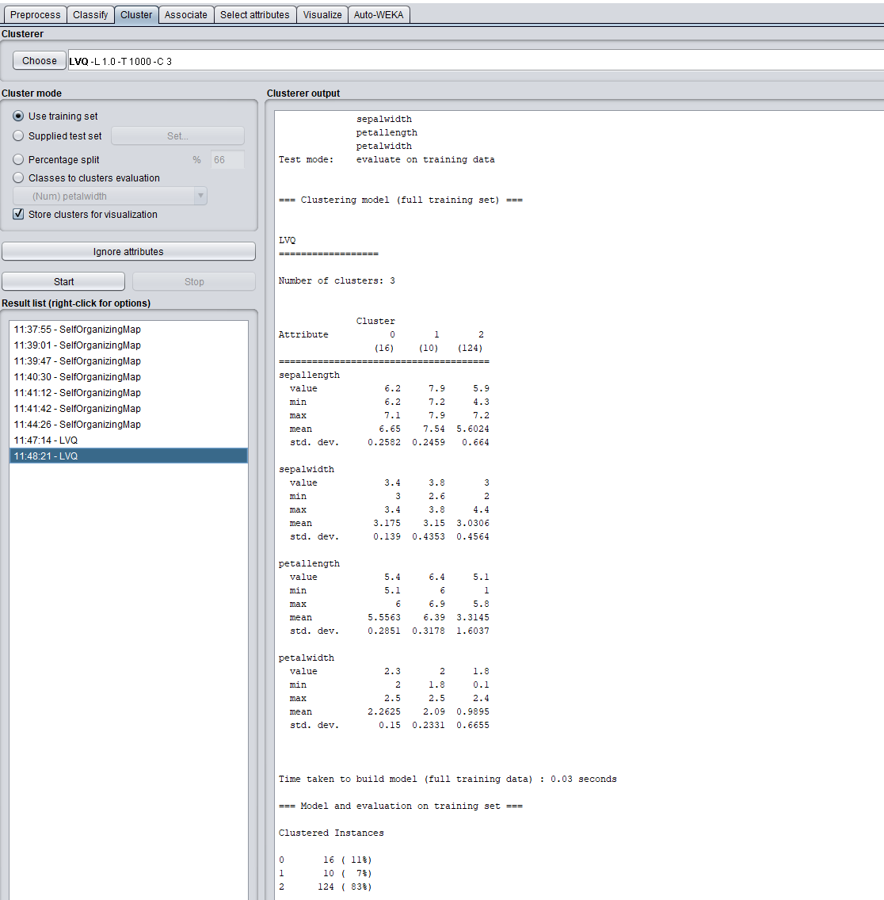
LVQ in WEKA for Iris data (unsupervised mode)

Slide 36
The Self-Organizing Map (SOM)
One method of learning the codebook was proposed by Kohonen
His idea was inspired by the way that mappings are learned in the topographic feature maps found in many brain areas
These feature maps consist of one- and two-dimensional sheets of neurons with lateral connections
Kohonen:
“The SOM is a new, effective software tool for the visualization of high-dimensional data. It converts complex, nonlinear statistical relationships between high-dimensional data items into simple geometric relationships on a low-dimensional display.
As it thereby compresses information while preserving the most important topological and metric relationships of the primary data items on the display, it may also be thought to produce some kind of abstractions.”

Slide 37
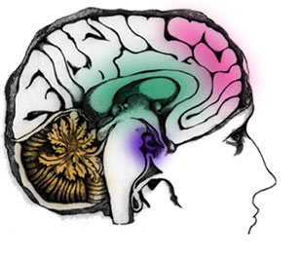
Feature Maps
Low pitch
Higher pitch
High pitch

Slide 38
Feature Maps
Sounds that are similar (‘close together’) excite neurons that are near to each other
Sounds that are very different excite neurons that are a long way off
This is known as topology preservation
The ordering of the inputs is preserved
If possible (perfectly topology-preserving)

Slide 39
Topology Preservation
Input Space
Map Space

Slide 40
SOM
Inputs

Slide 41
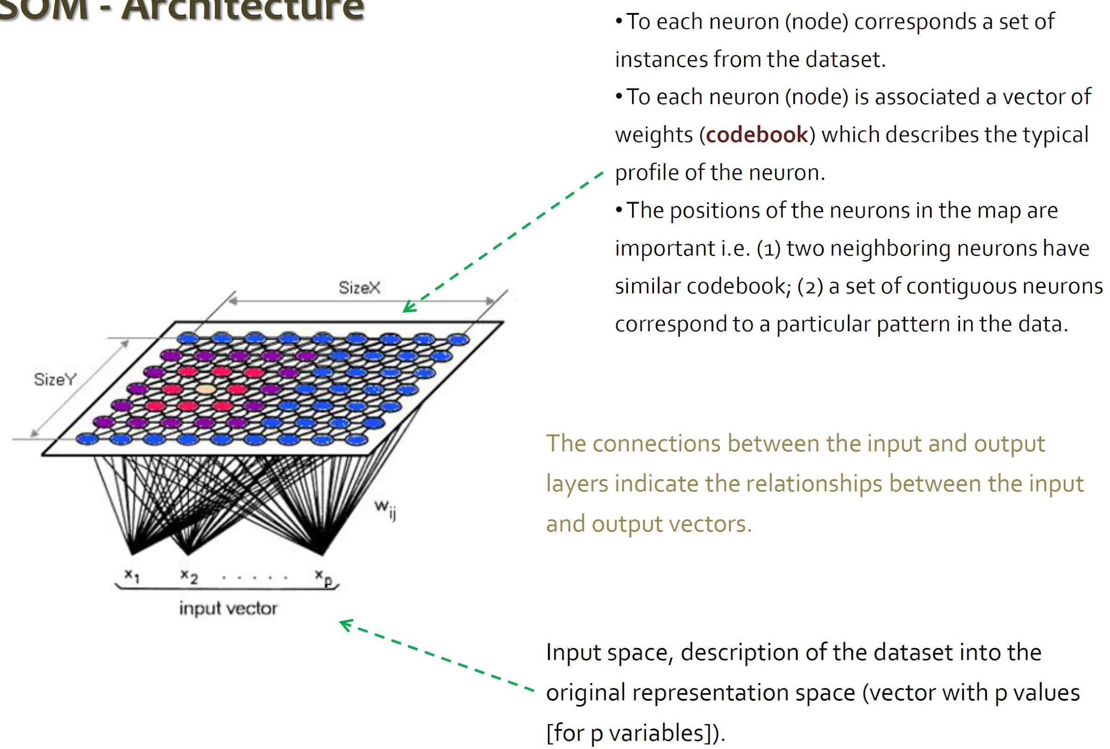
SOM

Slide 42
Neuron Connections
Strength
Distance
Graph of the strength of lateral connections for a feature mapping algorithm known as the ‘Mexican Hat’.

Slide 43
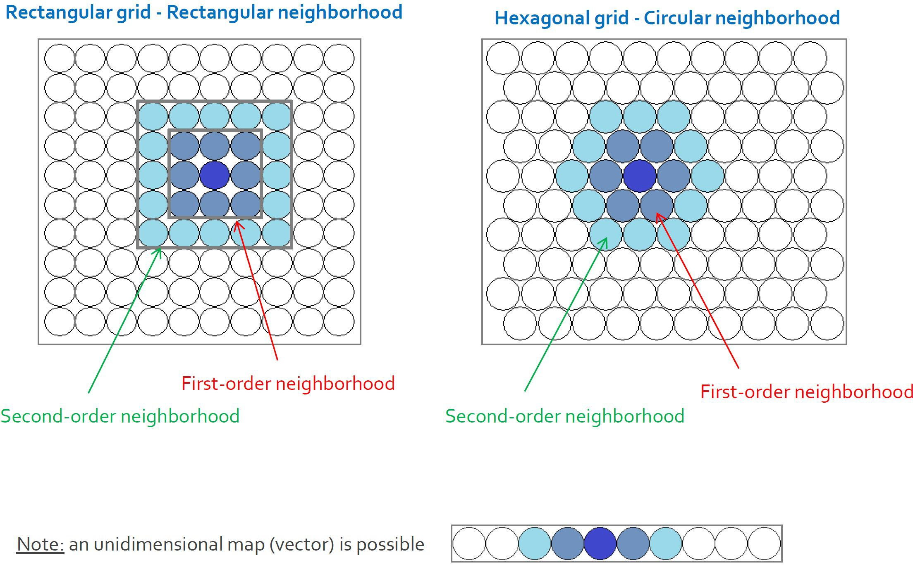
SOM Topology

Slide 44
Neuron Connections?
We don’t actually need the inhibitory connections
Just use a neighborhood of positive connections
How large should this neighborhood be?
Early in learning, network is unordered
Big neighborhood
Later on, just fine-tuning network
Small neighborhood

Slide 45
Everybody Needs Good Neighbors
Generate a neighborhood size function
Example
Euclidean distance to other nodes
Pick the nodes that are in the neighborhood
Decrease the neighborhood h(n_{b}, t) and the learning rate η_{n}(t) at each epoch

Slide 46
The Self-Organizing Feature Map
The weight vectors are randomly initialized
Input vectors are presented to the network
The neurons are activated proportional to the Euclidean distance between the input and the weight vector
The winning node has its weight vector moved closer to the input
So do the neighbors of the winning node
Over time, the network self-organizes so that the input topology is preserved

Slide 48
Self-Organization
Global ordering from local interactions
Each neurons sees its neighbors
The whole network becomes ordered
Understanding self-organization is part of complexity science

Slide 49
Network Size
We must predetermine the network size
Big network – overfitting!
Each neuron represents exact feature
Not much generalization
Small network
Too much generalization
No differentiation
Try different sizes and pick the best

Slide 50
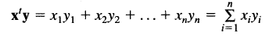
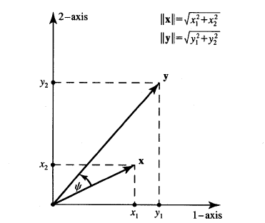
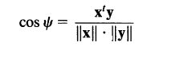
Some Mathematics
Scalar product (inner, dot):
Vectors x and y are said to be orthogonal (linear independent) if and only if their scalar product is zero.

Slide 51
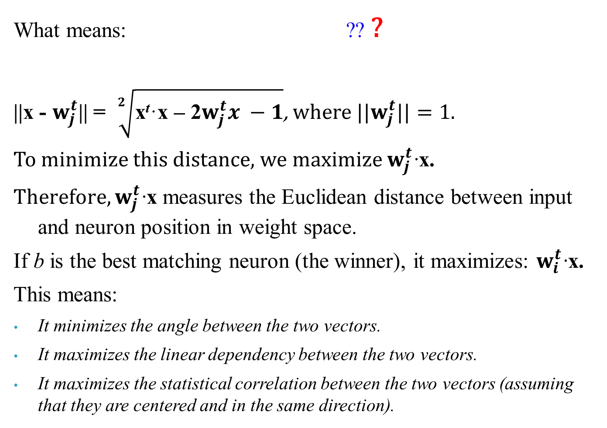
More Mathematics: Statistical Correlation Interpretation of the Euclidean Distance
What means: ?? ?
||x - $w_{j}^{t}$|| = $\sqrt[2]{\text{x}\text{t}\text{·}\text{x}\text{ – 2}w_{j}^{t}x −1}$, where ${||w}_{j}^{t}||=1$.
To minimize this distance, we maximize $w_{j}^{t}$·x.
${Therefore, w}_{j}^{t}$·x measures the Euclidean distance between input and neuron position in weight space.
If b is the best matching neuron (the winner), it maximizes: $w_{i}^{t}$·x.
This means:
It minimizes the angle between the two vectors.
It maximizes the linear dependency between the two vectors.
It maximizes the statistical correlation between the two vectors (assuming that they are centered and in the same direction).

Slide 52
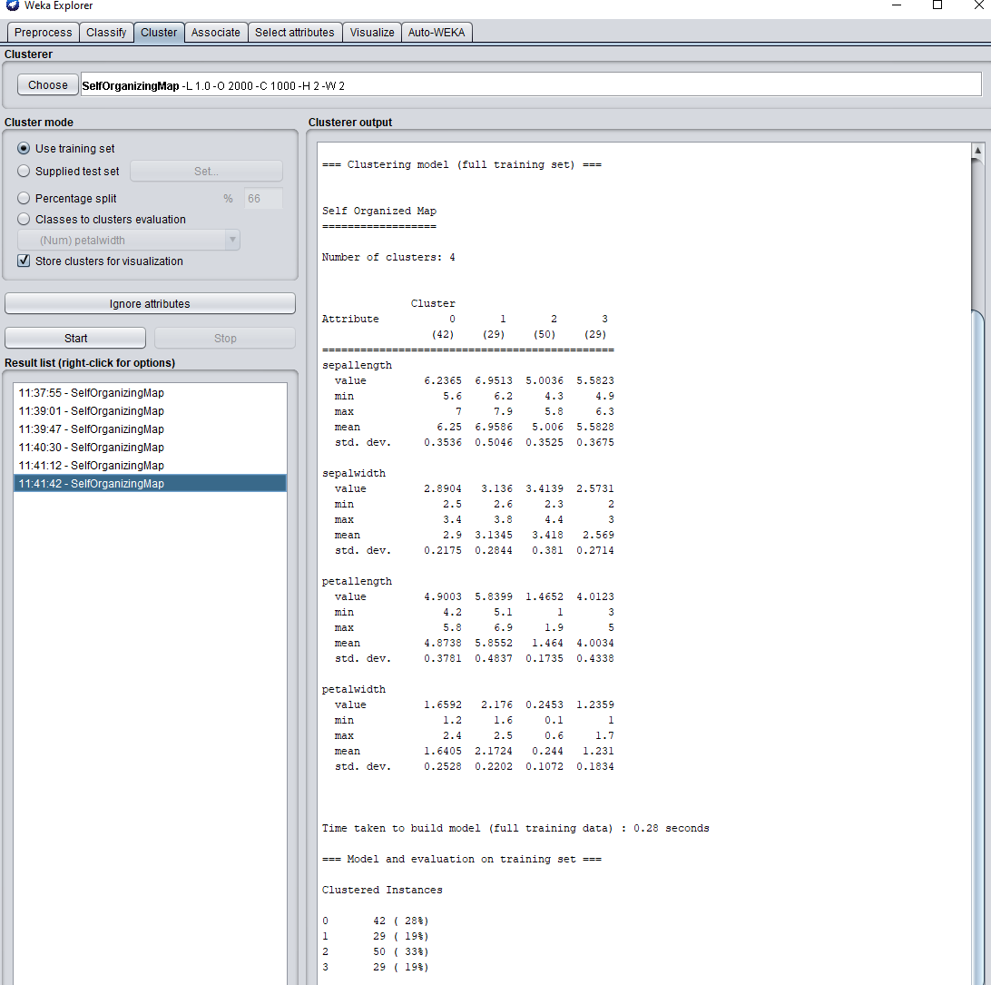
SOM in WEKA for Iris data (unsupervised mode)

Slide 53
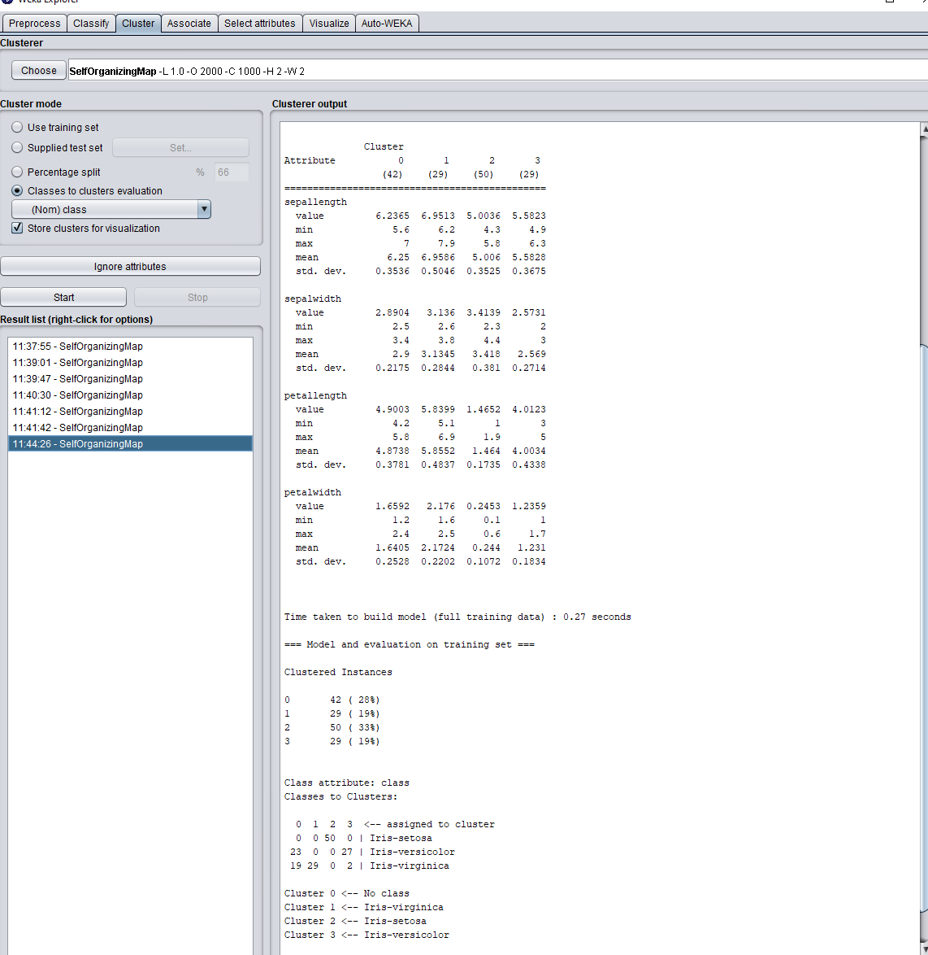
SOM in WEKA for Iris data (supervised mode)

Slide 54
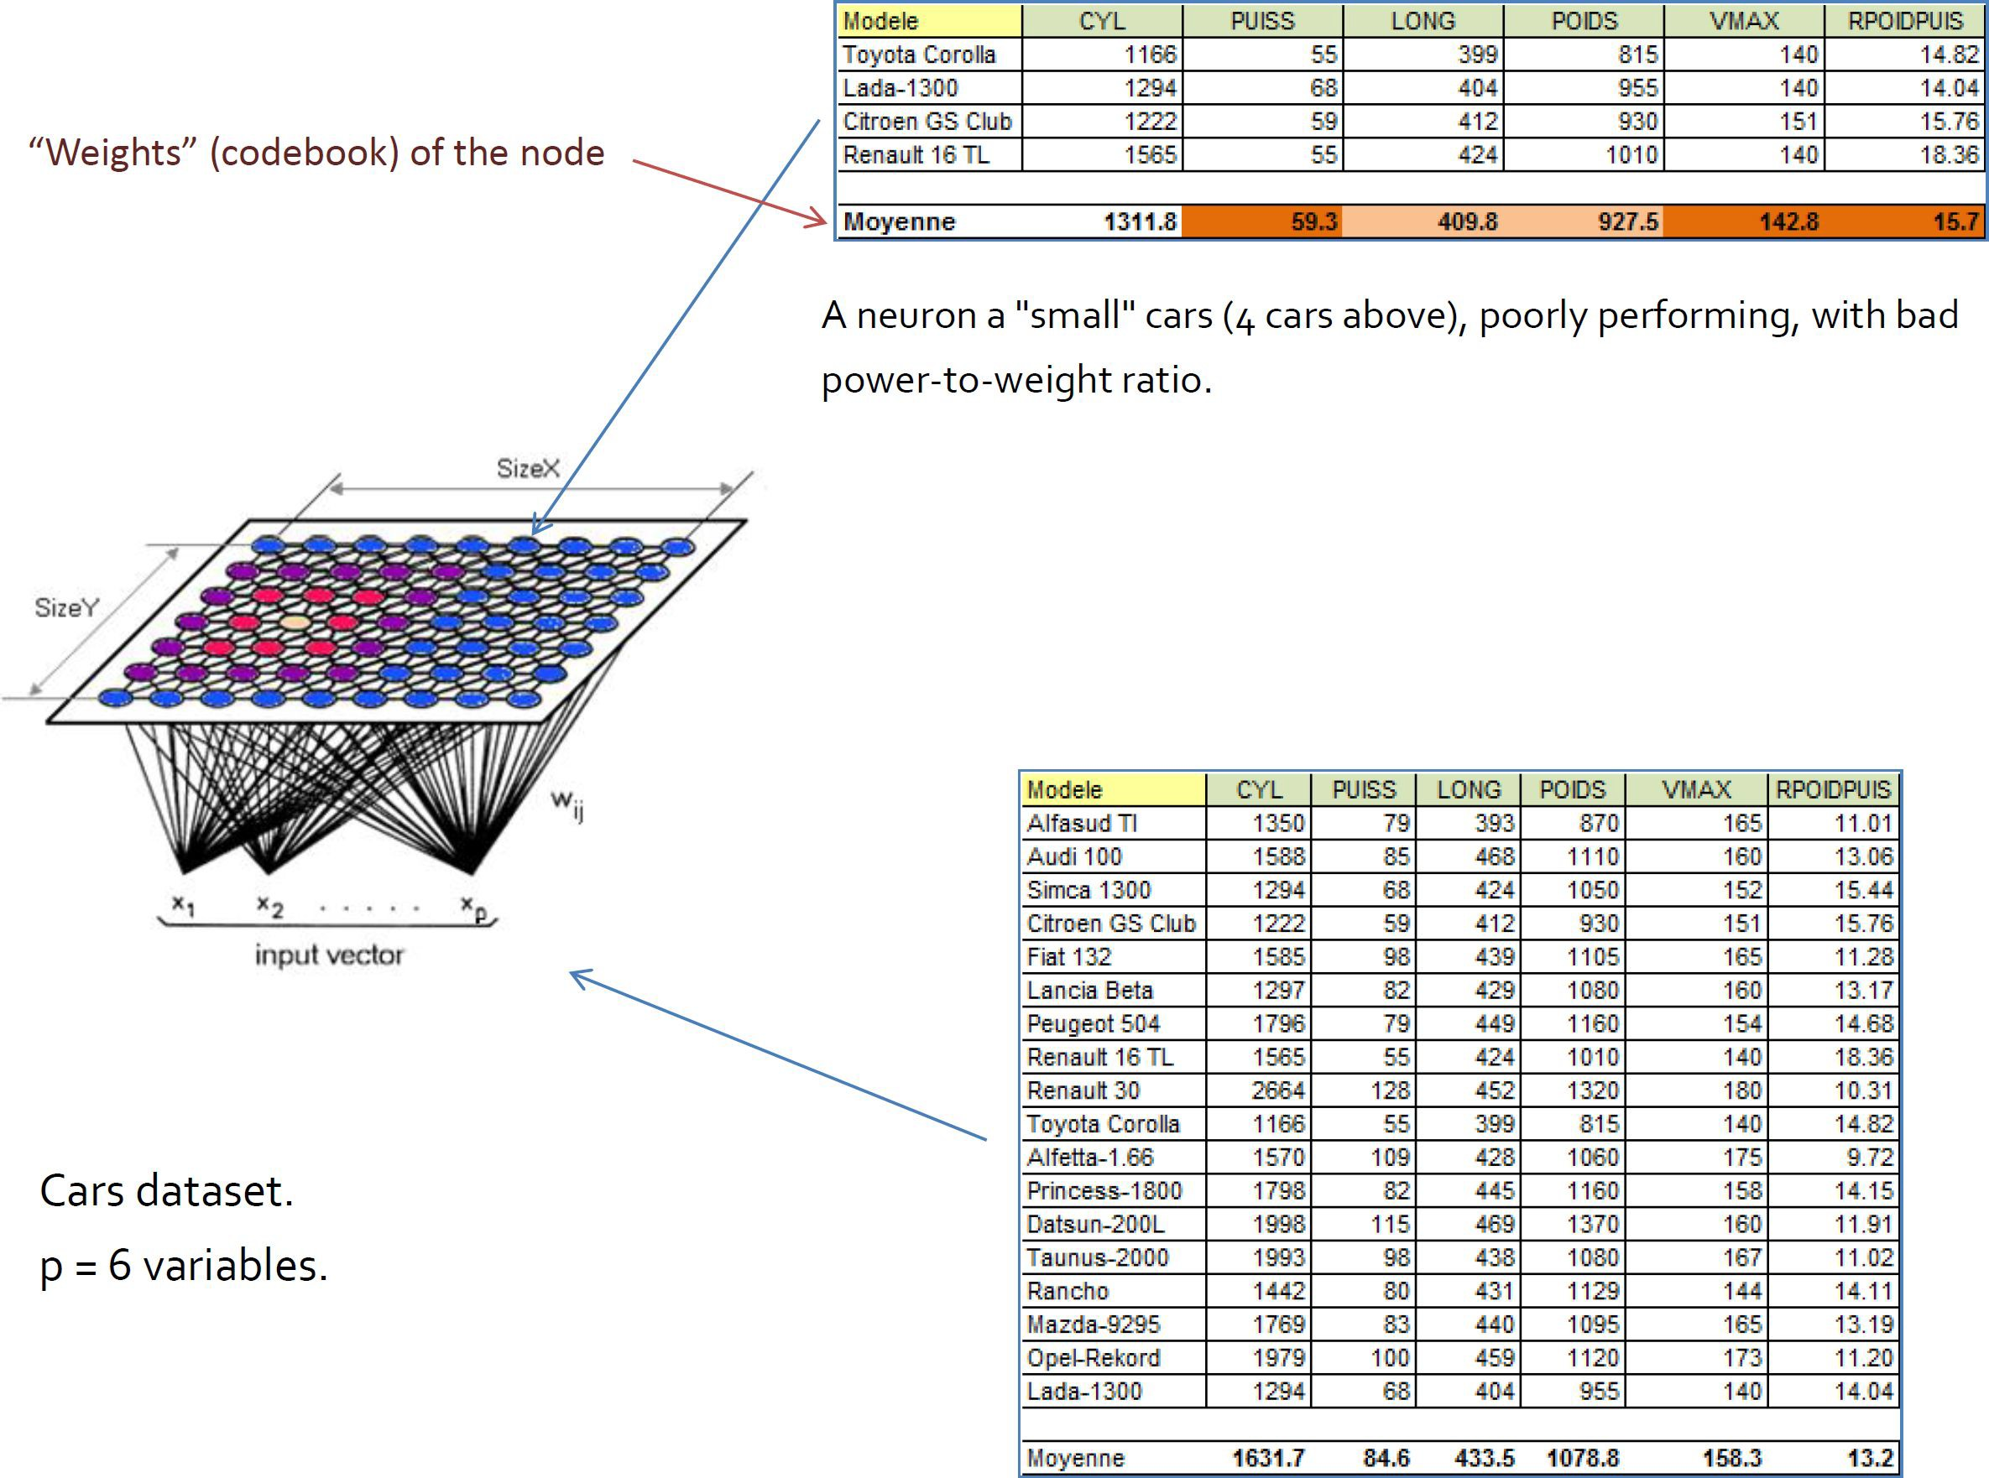
SOM: Application 1

Slide 55
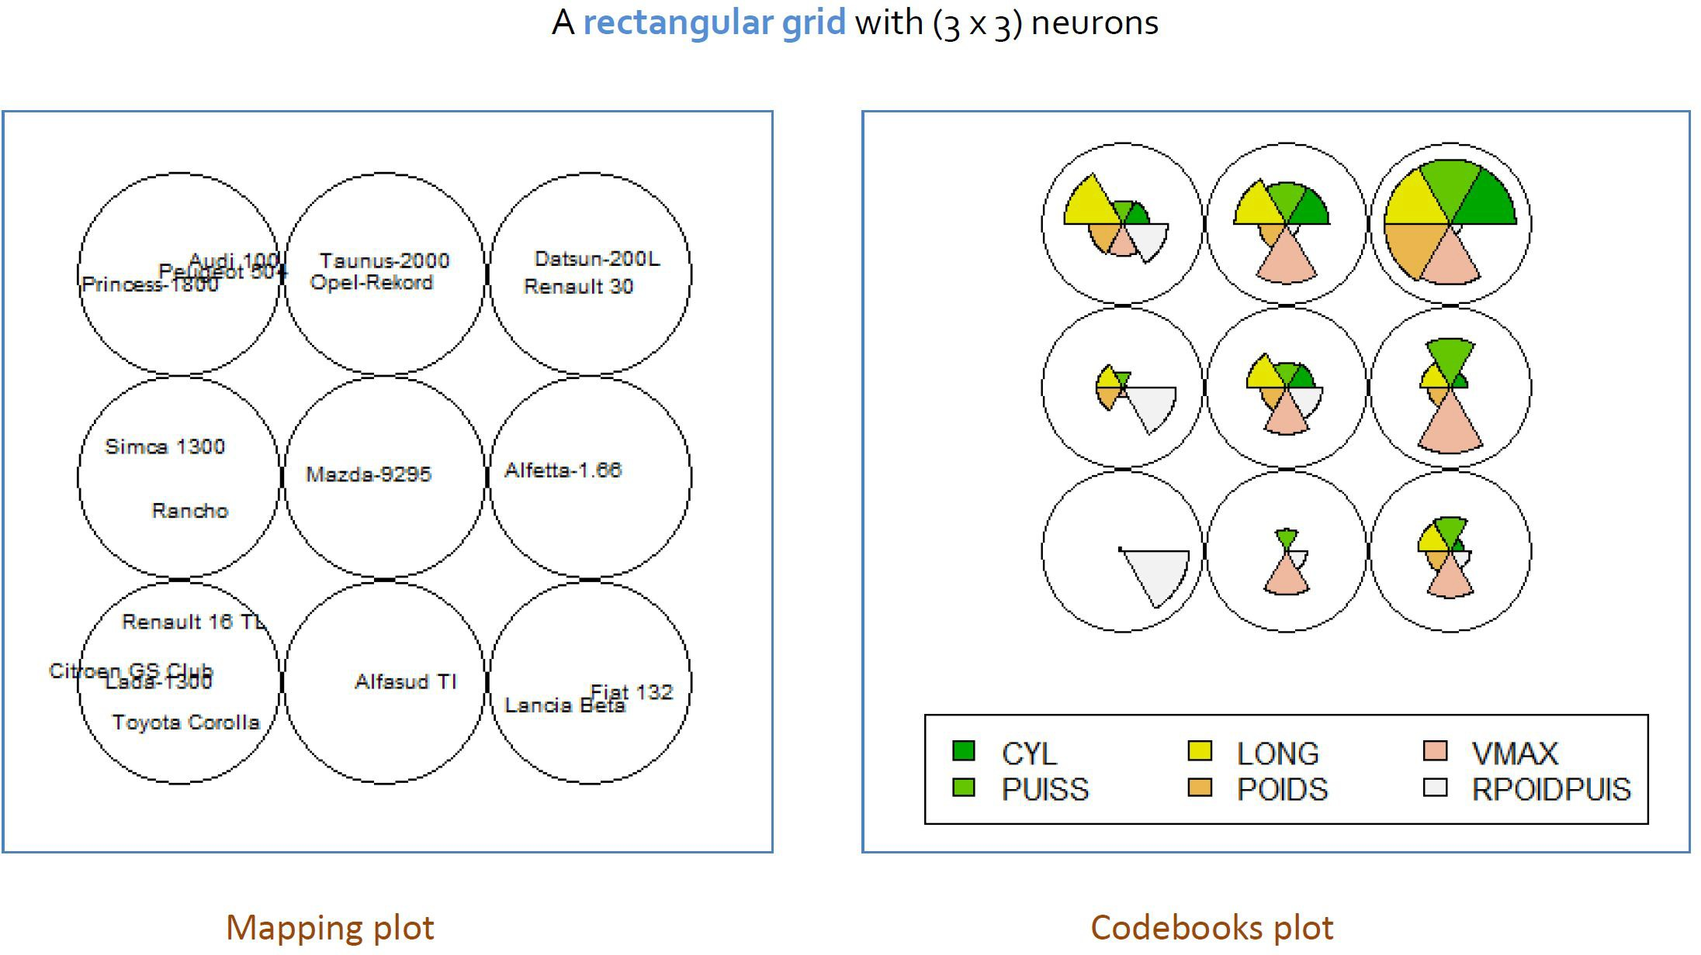
SOM: Application 1

Slide 56
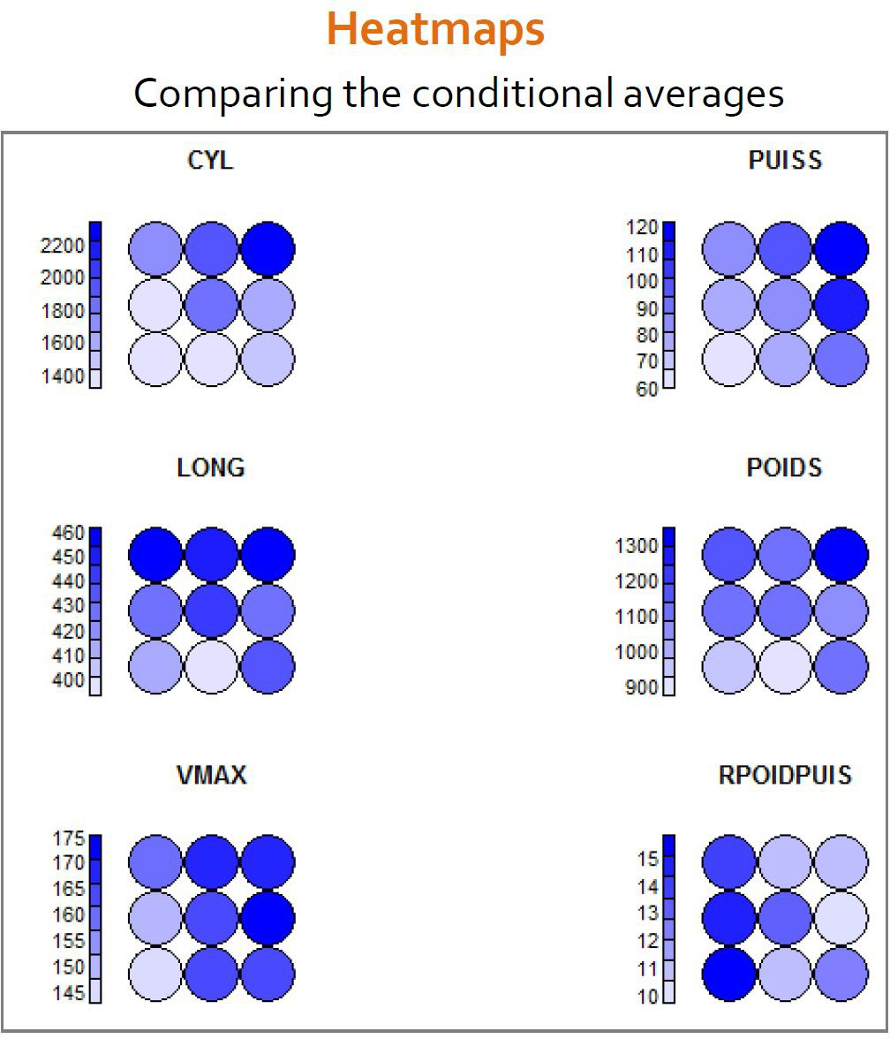
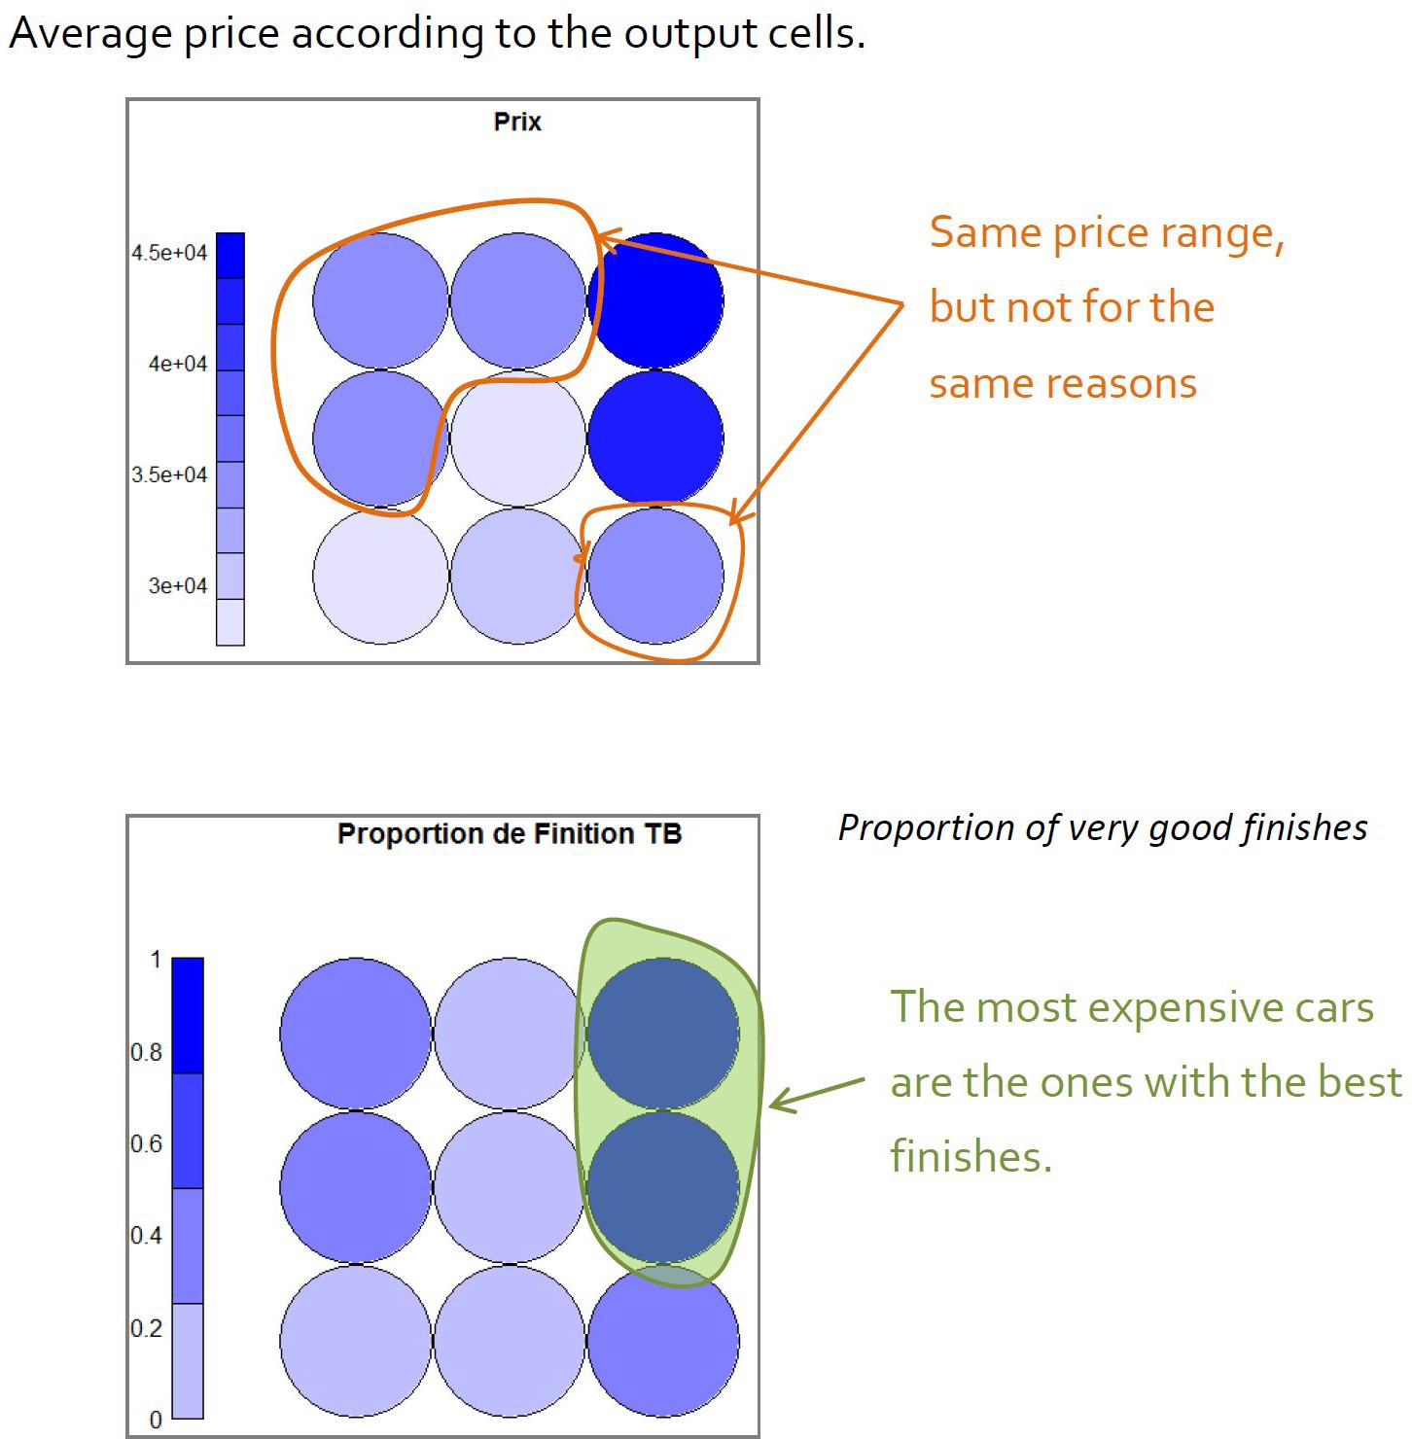
SOM: Application 1 - Interpretation

Slide 57
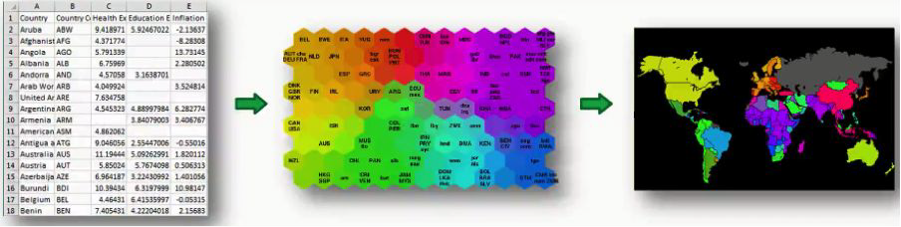
SOM: Application 2
39 variables
World Bank poverty indicators (1992)

Slide 58
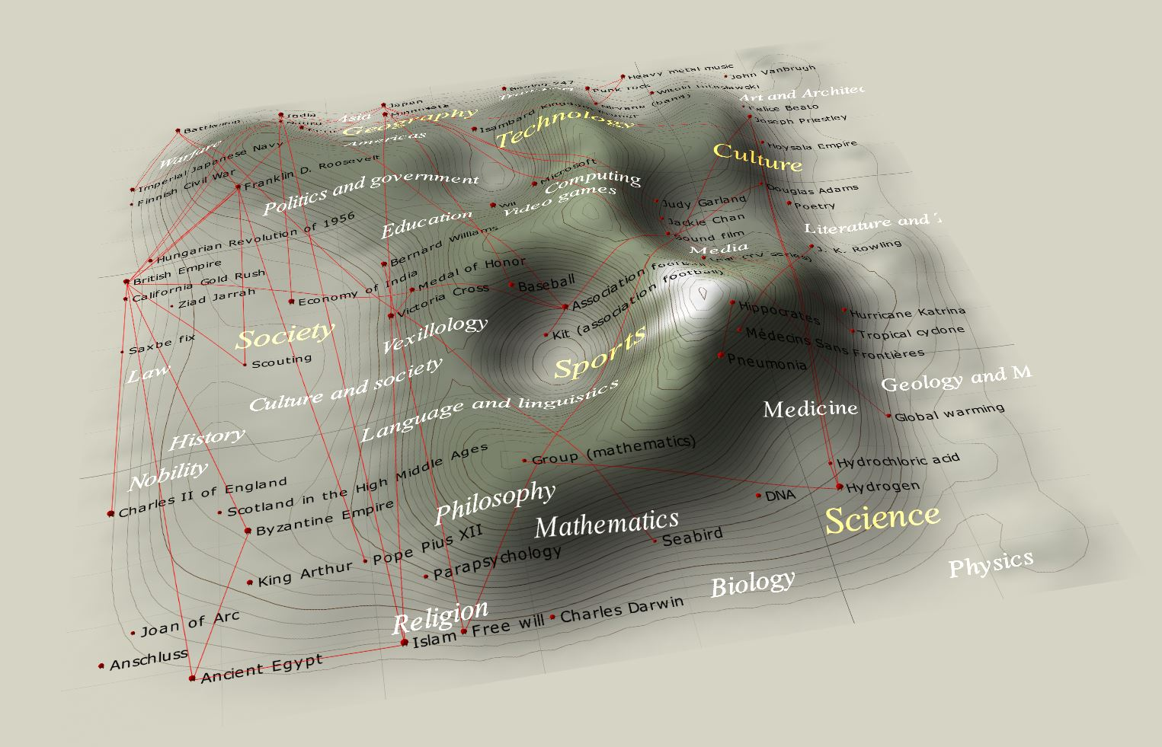
SOM: Application 3
Cartographical representation of a SOM based on Wikipedia featured article data (word frequency). Distance is inversely proportional to similarity. The "mountains" are edges between clusters. The red lines are links between articles.

Slide 59
Other Self-Organizing Networks
Fritzke’s “Growing Neural Gas”
animation: https://www.youtube.com/watch?v=3uo9-uhu8Z0
My own networks:
Lorentz, I., Andonie, R., Sasu L. Parallel Bayesian ARTMAP and Its OpenCL Implementation, Neural Processing Letters, 47, 2018, 491-507.
Andonie R., Sasu L. Fuzzy ARTMAP with Input Relevances, IEEE Transactions on Neural Networks, 17, 2006, 929-941.

